Slide 1
Case Study On E-Commerce Website Burger King
DBMS QUERIES

Slide 2
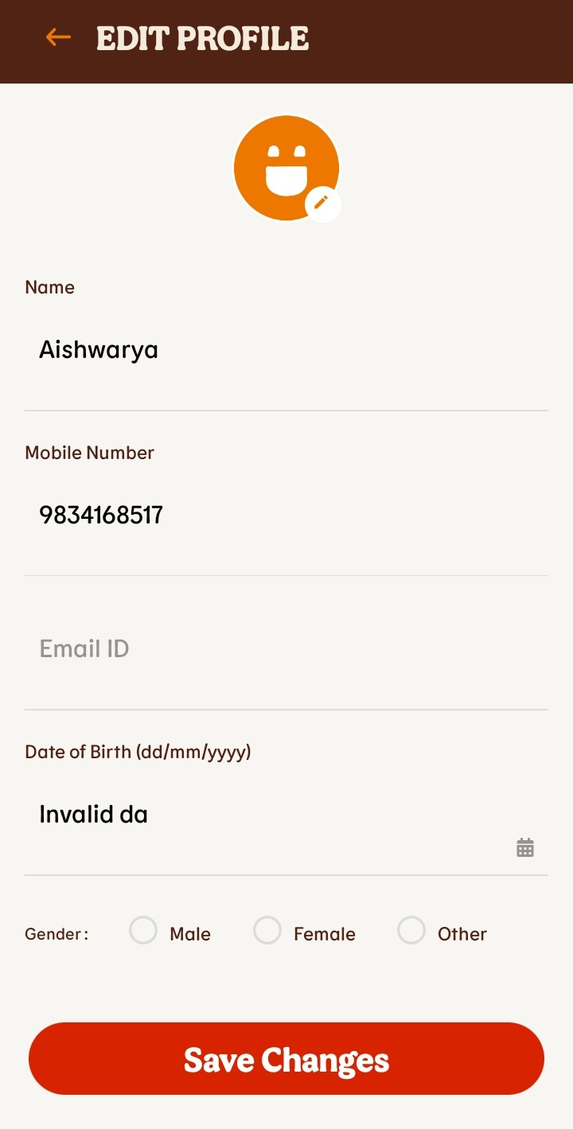
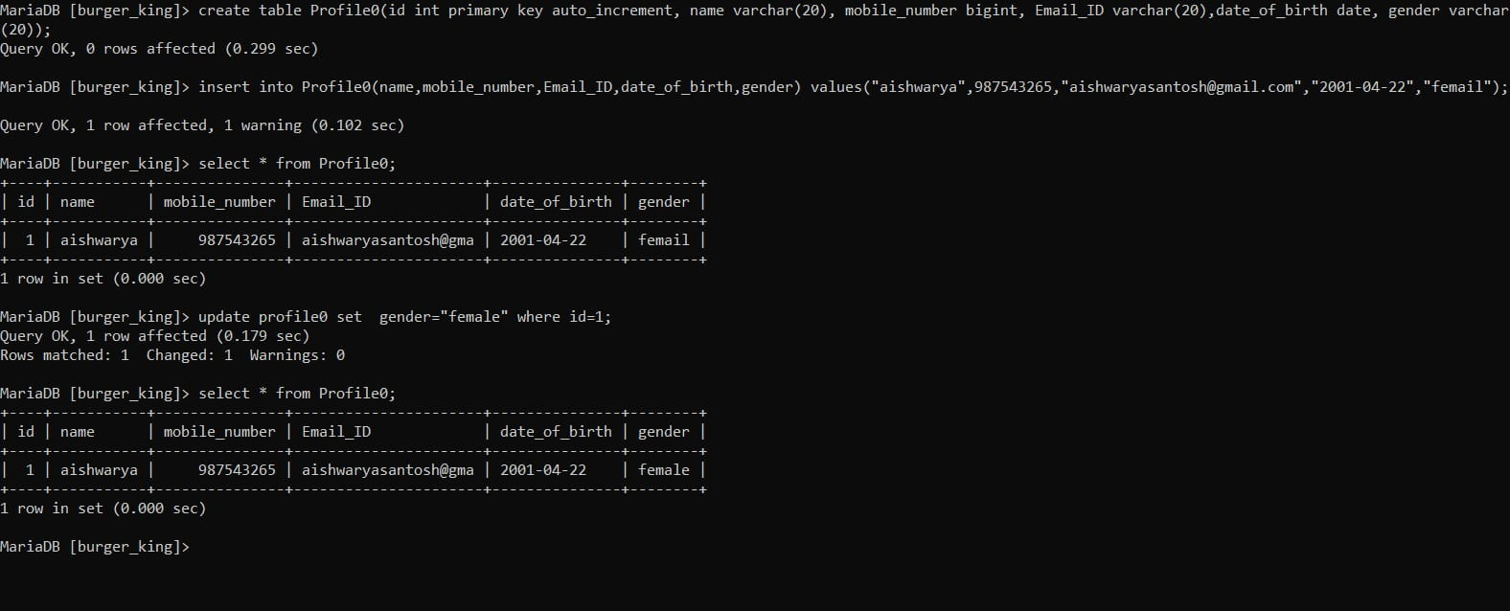
Using insert Query for create profile and update query for changes

Slide 3
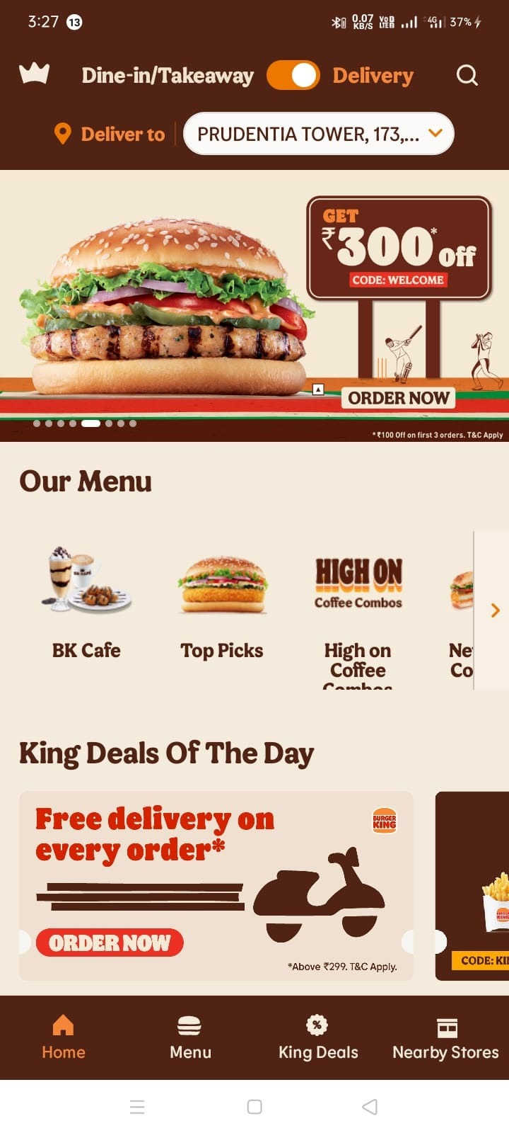
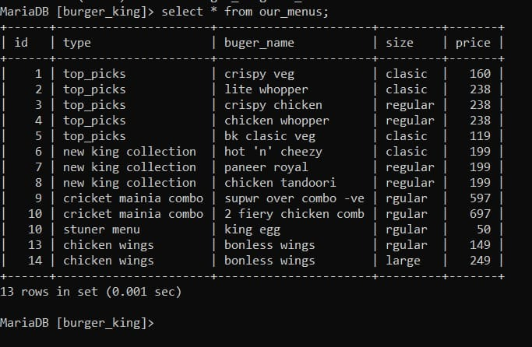
Using select query to show menu

Slide 4
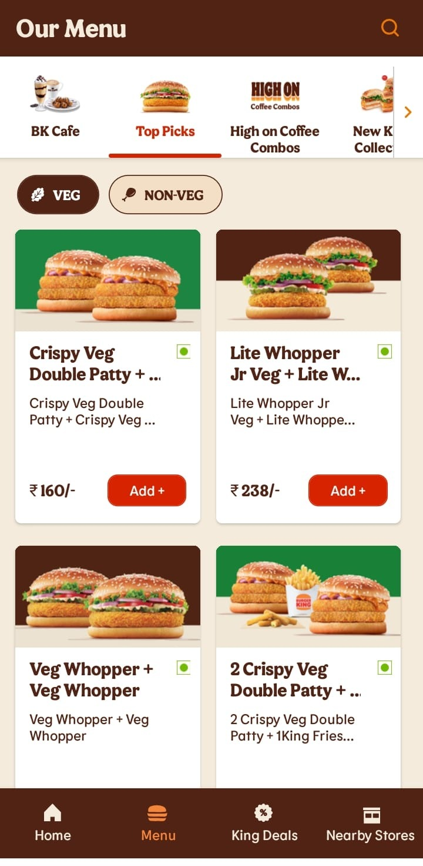
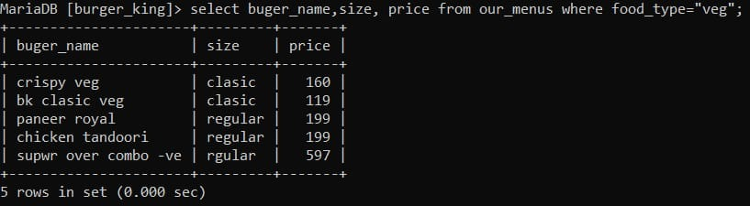
Using where clause for filter veg menu

Slide 5
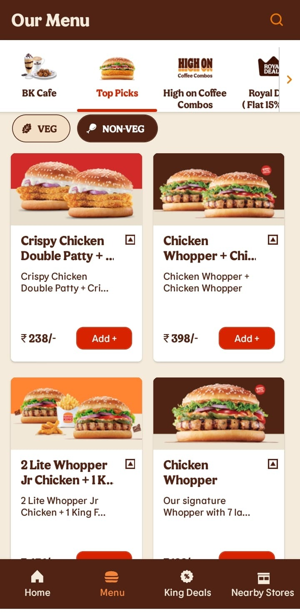
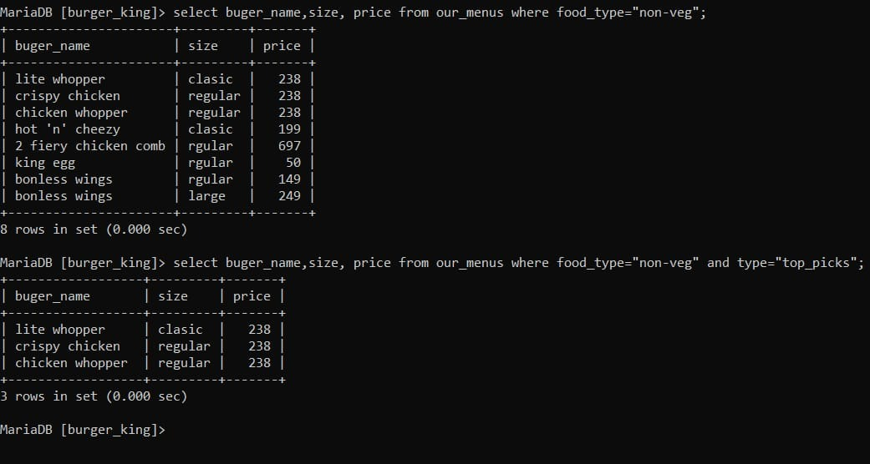
Using logical operator(and) for applying two condition

Slide 6
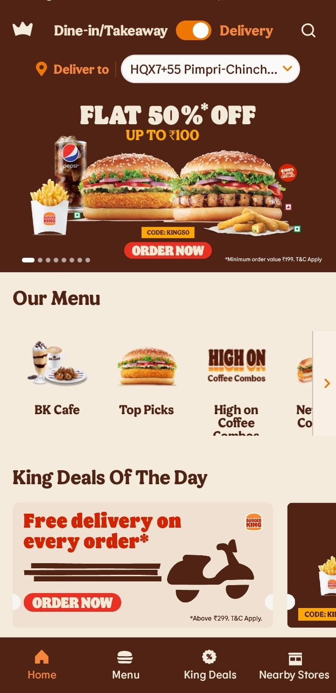
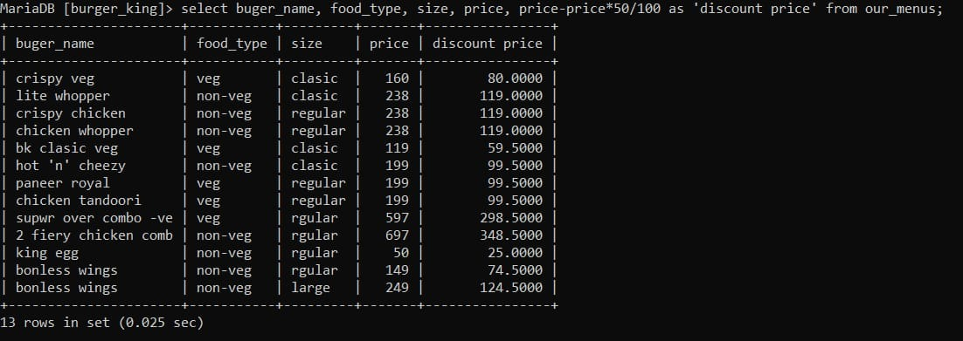
Using alising for showing temporary column as discount price

Slide 7
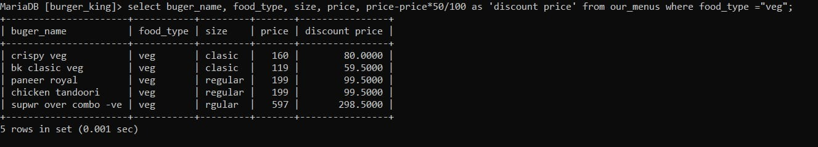
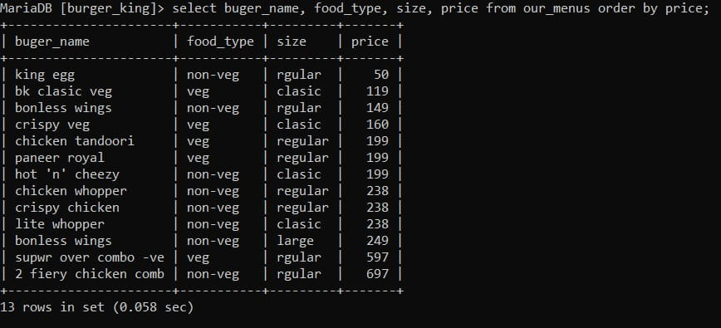
Applying discount only on veg product by using where clause and alising
Using order by clause on price for sorting items lowest to highest

Slide 8
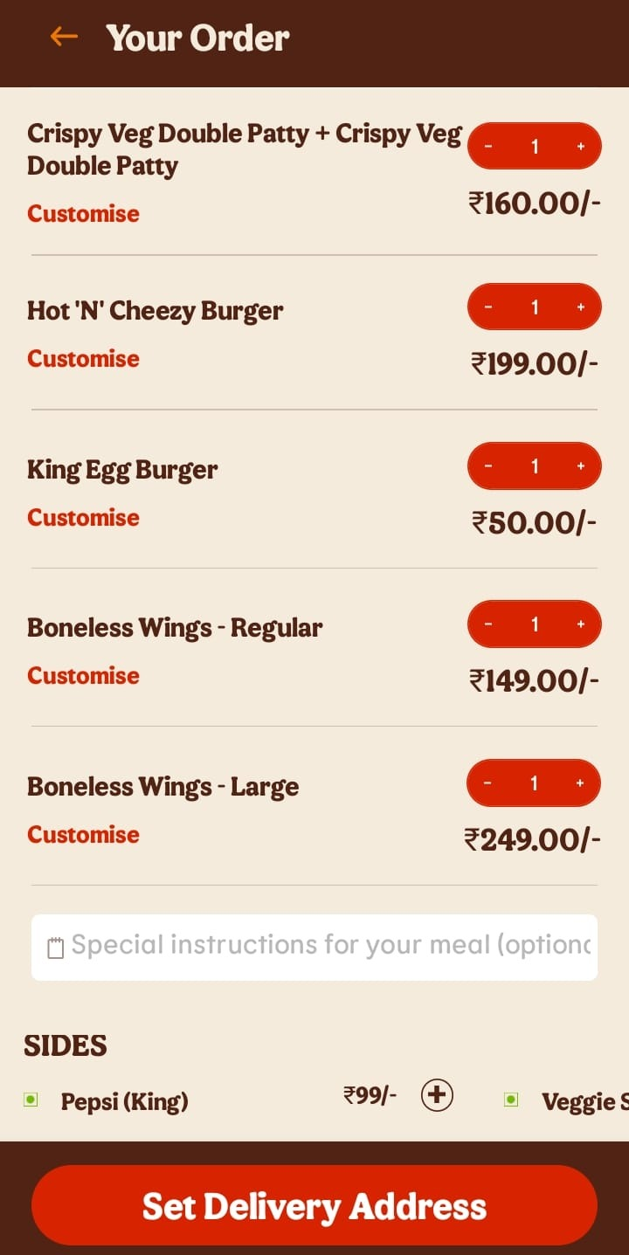
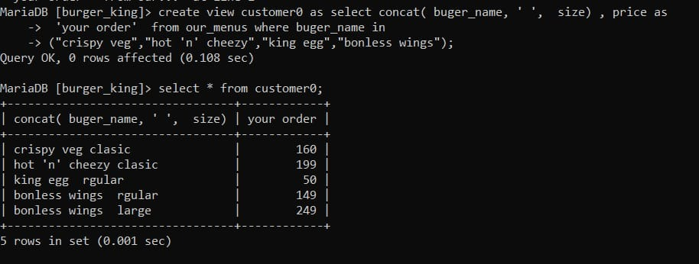
using simple view for showing items in your order

Slide 9
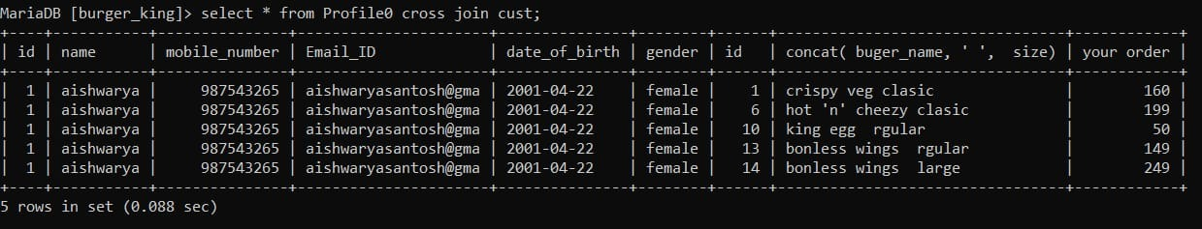
Using inner join query for adding items in your order

Slide 10
Thank You
By -: Vikram Singh Rajput

